Slide 1
Unit I Software Engineering Model

Slide 2
Unit Outline
Introduction to Software Engineering : The evolving role of software, Changing Nature of Software, Software myths.
A Generic view of process : Software engineering- A layered technology, a process framework, The Capability Maturity Model Integration (CMMI), Process patterns, process assessment, personal and team process models.
Process models : The waterfall model, Incremental process models, Evolutionary process models, The Unified process.

Slide 3
Chapter 1 Introduction to Software Engineering

Slide 4
Chapter 1 Introduction to Software Engineering
What is Software
The Evolving Role of Software
Changing Nature of Software
Software Myths

Slide 5
What is Software?
Software is a program and other operating information used by a computer.
Software is instructions (computer programs) that when executed provide desired function and performance
Software is documents that describe the operation and use of the programs.
Software is a set of items or objects that form a “configuration” that includes programs, documents, data

Slide 6
Software products
Generic products
Stand-alone systems that are marketed and sold to any customer who wishes to buy them.
Examples – PC software such as editing, graphics programs, project management tools; CAD software; software for specific markets such as appointments systems for dentists.
Customized products
Software that is commissioned by a specific customer to meet their own needs.
Examples – embedded control systems, air traffic control software, traffic monitoring systems.

Slide 7
Characteristic of software
Its characteristics that make it different from other things human being build.
Software is developed or engineered, it is not manufactured in the classical sense which has quality problem.
Software doesn't "wear out.”
but it deteriorates (due to change). Hardware has bathtub curve of failure rate ( high failure rate in the beginning, then drop to steady state, then cumulative effects of dust, vibration, abuse occurs).
Although the industry is moving toward component-based construction (e.g. standard screws and off-the-shelf integrated circuits), most software continues to be custom-built.
Modern reusable components encapsulate data and processing into software parts to be reused by different programs. E.g. graphical user interface, window, pull-down menus in library etc.

Slide 8
Changing nature of Software
System Software: System Software is a collection of programs written to service other programs.
Ex:(File management utilities, Operating system components, Drivers, Telecommunications)
Application Software: Application Software consists of standalone programs that solve a specific business need.
Ex:(Point on sales transaction processing, Billing system in shopping malls.)
Engineering and Scientific Software: This is the Software using different algorithms for different science and applications.
Ex:(System Simulation, Computer Aided Design.)

Slide 9
Changing nature of Software
Embedded Software: Embedded Software resides in read only memory and is used to control products and systems for the consumer and industrial markets. It has very limited and mysterious functions and control capability.
Product-line Software: It is designed to provide a specific facility for use by many different customers.
Ex:(word processing, spread sheets, graphics, multimedia etc.,)
Web based Software: The Web pages retrieved by a browser are software that includes executable instructions.
Ex:(Html, JavaScript, Perl etc.,)
Artificial Intelligence(AI) Software: AI Software makes use of non numerical algorithms to solve complex problems.
Ex: (Expert Systems, Pattern Recognition, Games etc.,)

Slide 10
Software Myths
What are Myths?
"Myths are stories told by people about people: where they come from, how they handle major disasters, how they cope with what they must and how everything will end. If that isn't everything what else is there?"
(or)
Myth is a Strong belief which is not true.

Slide 11
Types of myths
Software Myths are of three types:
Management Myths
Customer Myths
Practitioner's Myths

Slide 12
Management Myth
Managers with software responsibility, like managers in most disciplines, are often under pressure to maintain budgets, keep schedules from slipping, and improve quality.
Myth-1: We already have a book that's full of standards and procedures for building software, won't that provide my people with everything they need to know?
Reality: The book of standards may very well exist, but is it used? Are software practitioners aware of its existence? Does it reflect modern software engineering practice? Is it complete? Is it streamlined to improve time to delivery while still maintaining a focus on quality? In many cases, the answer to all of these questions is "no."

Slide 13
Management Myth
Myth-2: If we get behind schedule, we can add more programmers and catch up (sometimes called the Mongolian horde concept).
Reality: Software development is not a mechanistic process like manufacturing. In the words of. At first, this statement may seem counterintuitive. However, as new people are added, people who were working must spend time educating the newcomers, thereby reducing the amount of time spent on productive development effort. People can be added but only in a planned and well-coordinated manner.

Slide 14
Management Myth
Myth-3: If I decide to outsource the software project to a third party, I can just relax and let that firm build it.
Reality: If an organization does not understand how to manage and control software projects internally, it will invariably struggle when it outsources software projects.

Slide 15
Customer Myths
Customers may be defined as follows:
An outside company that has requested software under contract.
A person next to your desk.
A technical group.
A marketing or sales group.
Customer Myths lead to false expectations (by the customer) and ultimately, dissatisfaction with the developer.

Slide 16
Customer Myths
Myth-1: A general statement of objectives is sufficient to begin writing programs— we can fill in the details later.
Reality: A poor up-front definition is the major cause of failed software efforts. A formal and detailed description of the information domain, function, behavior, performance, interfaces, design constraints, and validation criteria is essential. These characteristics can be determined only after thorough communication between customer and developer.

Slide 17
Customer Myths
Myth 2: Project requirements continually change, but change can be easily accommodated because software is flexible.
Reality: It is true that software requirements change, but the impact of change varies with the time at which it is introduced.

Slide 18
Practitioner’s Myths
Unit 1
Topic 4
A Practitioner may be planning group, Development group, Verification group, Support group, Marketing/Sales.
Myth-1: Once we write the program and get it to work, our job is done.
Reality: Someone once said that "the sooner you begin 'writing code', the longer it'll take you to get done." Industry data indicate that between 60 and 80 percent of all effort expended on software will be expended after it is delivered to the customer for the first time.

Slide 19
Practitioner’s Myths
Myth-3: The only deliverable work product for a successful project is the working program.
Reality: A working program is only one part of a software configuration that includes many elements. Documentation provides a foundation for successful engineering and, more important, guidance for software support.

Slide 20
Practitioner’s Myths
Myth-2: Until I get the program "running" I have no way of assessing its quality.
Reality: One of the most effective software quality assurance mechanisms can be applied from the inception of a project—the formal technical review. Software reviews are a "quality filter" that have been found to be more effective than testing for finding certain classes of software defects.

Slide 21
Practitioner’s Myths
Myth-4: Software engineering will make us create voluminous and unnecessary documentation and will invariably slow us down.
Reality: Software engineering is not about creating documents. It is about creating quality. Better quality leads to reduced rework. And reduced rework results in faster delivery times.

Slide 22
Chapter 2 Generic View of process

Slide 23
Chapter 2 A Generic View of Process
Chapter 2
Topics
Software Engineering- A layered technology,
A process framework
The Capability Maturity Model Integration (CMMI)
Process patterns
Process assessment
Personal and team process models.

Slide 24
Introduction
Software is a logical rather than a physical system element.
Characteristic-1: Software is developed or engineered, it is not manufactured in the classical sense.
Characteristic-2: Software doesn't "wear out".
Characteristic-3: Although the industry is moving toward component-based assembly, most software continues to be custom built.

Slide 25
What is Software Engineering
The seminal definition:
[Software engineering is] the establishment and use of sound engineering principles to obtain software with better quality possible with in the estimated budget and the stipulated time.

Slide 26
Goal of Software Engineering
Goal of Software Engineering is:
The software produce high quality software at low cost

Slide 27
Software Engineering: A Layered Technology

Slide 28
Software Engineering: A Layered Technology
Process: a collection of work activities, actions and tasks reside within a frame work or a model
Methods: Provide the technical "how to" for building software; rely on a set of basic principles; encompass a broad array of tasks; include modeling activities
Tools: Provide automated or semi-automated support for the process and methods (i.e., CASE tools)

Slide 29
A Process Framework
A common process framework is established by defining a small number of framework activities that are applicable to all software projects, regardless of their size or complexity.
Umbrella activities are independent of any one framework activity and occur through out the process.
A number of task sets—each a collection of software engineering work tasks, project milestones, work products, and quality assurance points—enable the framework activities to be adapted to the characteristics of the software project and the requirements of the project team.
Finally, umbrella activities—such as software quality assurance, software configuration management, and measurement—overlay the process model.

Slide 30
A Process Framework

Slide 31
A Process Framework
Umbrella activities are independent of any one framework activity and occur throughout the process.
Umbrella Activities:
Software requirements management
Software project planning
Software project tracking and oversight
Software quality assurance
Software configuration management
Software subcontract management
Formal technical reviews
Risk management
Measurement – process, project, product
Reusability management (component reuse)
Work product preparation and production

Slide 32
Generic Process Framework
Applicable to almost all software projects
Communication
Planning
Modelling
Construction (coding & testing)
Deployment

Slide 33
The Capability Maturity Model Integration(CMMI)
Capability Maturity Model Integration (CMMI) is a process improvement approach that helps organizations improve their performance. CMMI can be used to guide process improvement across a project, a division, or an entire organization.
CMMI in software engineering and organizational development is a process improvement approach that provides organization with the essential elements for effective process improvement. CMMI is registered in the U.S. Patent and Trademark Office by Carnegie Mellon University.

Slide 34
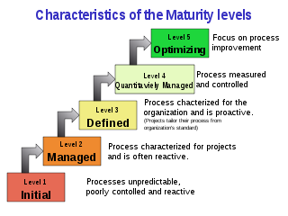
The Capability Maturity Model Integration(CMMI)

Slide 35
The Capability Maturity Model Integration(CMMI)
Level 1: Initial : The process area is either or not performed or the goals not achieved
Level 2: Manageable : All level 1 criteria have been satisfied. In addition all work associated with the process are confined to organizational defined policy
Level 3: Defined: All level 1 criteria have been satisfied. In addition, the process is tailored from the organisation set of standard processes

Slide 36
The Capability Maturity Model Integration(CMMI)
Level 4: Quantitatively Managed :All level 3 criteria have been satisfied. In addition, the process area is controlled and improved using measurement and quantitative measurement.
Level 5: Optimizing. All level 4 criteria have been satisfied. In addition, the process area is adapted and optimized using quantitative measurement to meet change in customer needs.

Slide 37
Process Pattern
Process patterns define a set of activities, actions, work tasks, work products and related behaviors that must be done to complete the project.
In general process pattern defines a template
Template for defining a process pattern: (by Ambler):
Pattern name : The pattern is provided with a meaningful name to describe the function in software process (E.g.: Customer communication)
Type: The type of pattern
Task pattern : Defines a software engineering action or work task
Stage pattern : Defines a framework activity for the process
Phase pattern : Defines the sequence of framework activities that occur with the process
- Initial Context : Conditions initialized before applying to the pattern

Slide 38
Process Assessment
The existence of software process doesn’t give guarantee that software will be delivered on time , meet requirements
The assessment is a solution to test the above

Slide 39
Process Assessment
Software Process
Is examined by
SPA
Identifies Capabilities and risk of SP
Identifies modification
To SPA
Software Process
Assessment
Leads to
Leads to
Software Process
Improvement
Capability
Determination
Motivates

Slide 40
Process Assessment
Different approaches to software process assessment:
Standard CMMI assessment method for process Improvement (SCAMPI)
CMM- Based Appraisal for Internal Process Improvement (CBA IPI)
SPICE (ISO/IEC 15504)
International Organization for Standardization (ISO 9001:2000) for Software :
Applies to any organization that wants to improve overall quality of the product , system.
Plan-do-check-act cycle

Slide 41
Personal Process Models
The Personal Software Process (PSP) is a structured software development process that is intended to help software engineers understand and improve their performance, by using a "disciplined, data-driven procedure".
The PSP was created by Watts Humphrey to apply the underlying principles of the Software Engineering Institute's (SEI) Capability Maturity Model (CMM) to the software development practices of a single developer.
It claims to give software engineers the process skills necessary to work on a Team Software Process (TSP) team.

Slide 42
Personal Process Models
The PSP helps software engineers to:
Improve their estimating and planning skills.
Make commitments they can keep.
Manage the quality of their projects.
Reduce the number of defects in their work.
The goal of the PSP is to help developers produce zero-defect, quality products on schedule. Low-defect and zero defect products have become the reality for some developers and TSP teams.

Slide 43
5 framework activities of PSP
Planning : Requirement -> size and resource estimation, defect estimation.
-All metrics are recorded on worksheet or template.
High level design : Prototype are build when needed.
High level design review : Formal verification methods are applied to identify errors
Development : Component level design is refined and reviewed
Postmortem : Using measures and metrics collected , the effectiveness of the process is determined

Slide 44
Team Software Process (TSP)
Build self-directed, managers, software process, improvement guidance, teaching.
The TSP is intended to improve the levels of quality and productivity of a team's software development project

Slide 45
Team Software Process (TSP)
TSP helps organizations to
Build self directed team that plan and track the work.
Show managers how to coach and motivate their team and sustain peak performance
Accelerate software process improvement
Provide improvement guidance to high maturity organization
Facilitate university teaching of industrial grade team skills

Slide 46
Framework for TSP
Launch
High level design
Implementation
Integration
Test
Postmortem
TSP makes use of wide variety of
Scripts, forms and standards
Team must a full commitment to the process and undergo training to apply properly

Slide 47
Unit I Chapter 3 Process Models

Slide 48
Chapter 3 Process Models
Introduction :
A process model specifies a general process, usually as a set of stages in which a project should be divided
The order in which the stages should be executed
Any other constraints and conditions on the execution of stages.
Selection of process model is based on:
the nature of the project and application.
the methods and tools to be used
the controls and deliverables

Slide 49
Process Model
Linear Sequential Model
The Waterfall Model
Incremental Process Models
Incremental Model
RAD Model
Evolutionary Process Models
Prototyping Model
Spiral Model
Concurrent Development Model
The Unified Process

Slide 50
Linear Sequential Model
Waterfall Model

Slide 51
Waterfall model
The waterfall model is also called as linear sequential model
To clearly identify the end of the phase and beginning of the next stage

Slide 52
Feature of waterfall model
A waterfall is easy to flow
It can be implemented for any size of project
Every stage has to be done separately at the right time so you cant jump stages
Documentation is produced at the every stage of a waterfall model allowing people to understand what has been done
Testing is done at every stage

Slide 53
Phases of waterfall model
Waterfall model has 5 different phases, they are
Requirement gathering
Design
Coding
Testing
Maintenance

Slide 54
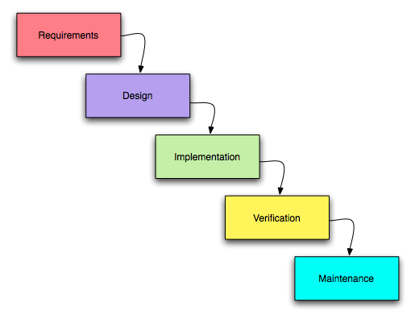
Phases of waterfall model

Slide 55
Requirement analysis
This is the 1st phase in the waterfall model which include meeting the customer and understanding his requirements
This is the crucial stage as any misinterpretation at this stage may give rise to problem later
Software definition must be detailed and accurate
Important to understand the customer requirement and expectation

Slide 56
Design
The customer requirements are broke down into logical modules
Software and hardware requirements for every module are identified and designed accordingly
Also inter relation of between various logical modules is established
Fundamentals for programming and implementation

Slide 57
Design
It is an intermediate step between requirements analysis and coding
Design focuses on attributes such as
Data structures
Software architecture
Algorithm
The design needs to be documented for future use

Slide 58
Coding
Coding is the step ; design is translated into machine readable form
If design is done with sufficient details then coding can be efficient.
Coding is done in small module rather than doing for the whole software
According to design , programmers do code, class and structure for whole software

Slide 59
Testing
In this stage, both individual components and the integrated ones are verified to ensure they are error free
Testing is done for both the
1.Hardware
2.software

Slide 60
Maintenance
This is the final stage of the waterfall model, in which the completed software is handed over to the client
After deployment it is the duty of the developer is to undertake frequent maintenance activities
If the customer suggests changes the software process has to be performed all over again

Slide 61
Advantage of waterfall model
The waterfall model is easy to implement
For implementation of small systems waterfall will be useful
The project requires the fulfillment of one phase before proceeding to the next
It is easier to develop various software through method in short span of time

Slide 62
Disadvantages of waterfall model
The requirement analysis is done initially and sometimes it is not possible to state all the requirements at the beginning
The customer can see the working model only at the end
If we want to go back track it is not possible
It is difficult is difficult to follow the sequential flow in software development process

Slide 63
Incremental Model

Slide 64
Incremental Model
Incremental model is one which combines the elements of waterfall model which then are applied in iterative manner
It delivers a series of releases called increments which provide more functionality for the clients as each increment is delivered

Slide 65
Waterfall in incremental model

Slide 66
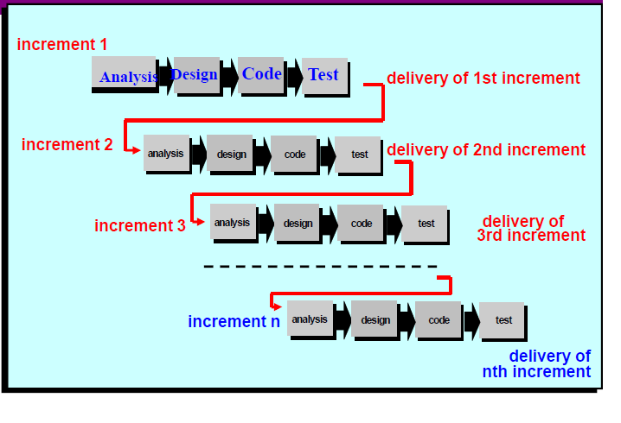
Increments or builds

Slide 67
Advantages
Sequences
It proceeds from one phase to the next in sequential manner
Easier to debug
As there are different builds, so it is easier to debug
Lower cost
Initial product delivery is faster and lower costs
Work with fewer people
Ever increment can be implemented with fewer people
Less use of hardware
May be able to plan every increment in the same way that avoids the use of hardware

Slide 68
Incremental Model
RAD Model

Slide 69
RAD model
Rapid Application Development emphasizes on short development cycle
It’s a high speed adaption of the waterfall model
Rapid development is possible by using component based construction
Requirements are well understood and the scope is constrained

Slide 70
Phases of RAD model
Communication
Planning
Modelling
Construction
Deployment

Slide 71
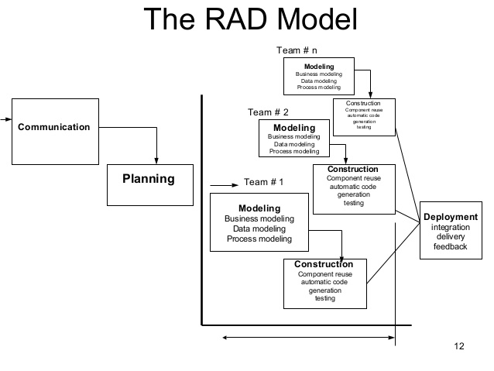
RAD model
60 – 90 days

Slide 72
Communication
To understand the business problem and the information characteristics that the software must have

Slide 73
Planning
Planning is essential for multiple software teams work in parallel

Slide 74
Modelling
Establishes design representation that serves as the basis for RAD’s construction
It is further more encompasses into three phases
Business modelling
Data modelling
Process modelling

Slide 75
Business modelling
The information flow among business functions is defined by answering questions like
what information drives the business process
what information is generated
who generates it
where does the information go
who process it and so on

Slide 76
Data modelling
The information collected from business modeling is refined into a set of data objects (entities) that are needed to support the business
The attributes (character of each entity) are identified and the relation between these data objects (entities) is defined.

Slide 77
Process modelling
The data object defined in the data modeling phase are transformed to achieve the information flow necessary to implement a business function
Processing descriptions are created for adding, modifying, deleting or retrieving a data object.

Slide 78
Construction
Emphasizes the use of pre existing software components and the application of automatic code generation.

Slide 79
Deployment
Establishes a basic subsequent iteration.

Slide 80
Advantages
Quick initial reviews are possible.
Constant integration isolate problems and encourage customer feedback.
Flexible and adaptable to changes.
RAD realizes an overall reduction in project risk.
RAD generally incorporates short development cycles - users see the RAD product quickly.

Slide 81
Disadvantages
Requires a systematic approach for modularized.
Requires highly skilled and well-trained developers.
Product may lose its competitive edge because of insufficient core functionality and may exhibit poor overall quality.

Slide 82
Evolutionary Process Model

Slide 83
Evolutionary Process Model
Requirements often change as development proceeds
Classic process models are not designed to deliver a production system due to their assumption on the following
A complete system will be delivered after the linear sequence is completed
Customers know what they want at the early stage

Slide 84
Evolutionary Process Model
The reality in software development process is that
a lot of requirement changes during the production courses
A lot of iterative activities and work because of the evolutionary nature of the software production

Slide 85
Evolutionary Model
Prototype Model

Slide 86
Prototype Model
Before carrying out the development of the actual software , a working prototype of the system should be built.
A prototype is a toy implementation of the system

Slide 87
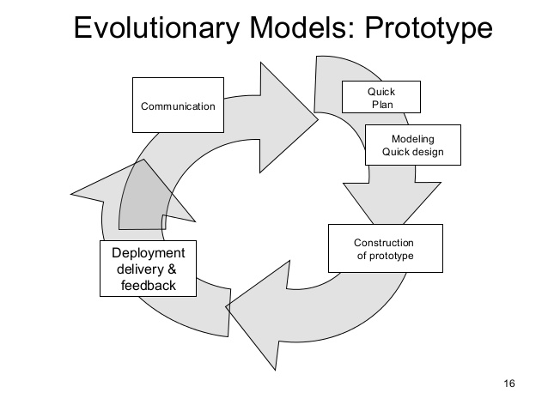
Prototype Model

Slide 88
Communication
A prototyping model begins with requirements analysis , and the requirements of the system are defined in detail. The user is interviewed in order to know the requirements of the system.

Slide 89
Quick design
When requirements are know , a preliminary design or quick design for the system is created . It is not a detailed design , however , and includes the important aspects of the system, which gives an idea of the system to the user

Slide 90
Construction
Information gathering from quick design is modified to form a prototype . It represents a ’rough’ design of the required system.

Slide 91
Deployment delivery & feedback
the proposed system is presented to the user for consideration as part of the development process.
Once the user evaluates the prototype, it is refined according to the requirements .When the user is satisfied with the developed prototype , a final system is developed based on the final prototype
The final system is thoroughly evaluated and tested followed by routine maintenance on a continuing basis to prevent large-scale failures and to minimize downtime

Slide 92
Advantages
Provides a working model to the user early in the process , enabling early assessment and increasing user confidence.
The developer gains experience and insight by developing a prototype , thereby resulting in better implementation of requirements.
Helps in reducing risks associated with the project.

Slide 93
Disadvantages
If the user is not satisfied with the developed prototype, then a new prototype is developed . This process goes on until a perfect prototype evolves . Thus , this model is time consuming and expensive.
The developer loses focus of the real purpose of prototype and compromises on the quality of the product . For example , he may apply some of the inefficient algorithms or inappropriate programming languages used in developing the prototype .

Slide 94
Evolutionary Model
Spiral Model

Slide 95
Spiral Model
Proposed by Boehm
Couples the iterative nature of prototype with systematic approach of the linear sequential model
Has same potential of the RAD model
Using the spiral model software is developed in a series of incremental releases
During early iteration, increments will be a paper or prototype release
During later iteration, increasingly more complete versions of the engineering system are produced
Spiral model is divided into number of framework activities called tasks regions

Slide 96
Phases of spiral model
Communication
Planning
Risk analysis
Engineering
Construction and release
Customer evaluation

Slide 97
Evolutionary Process Model
Spiral Model

Slide 98
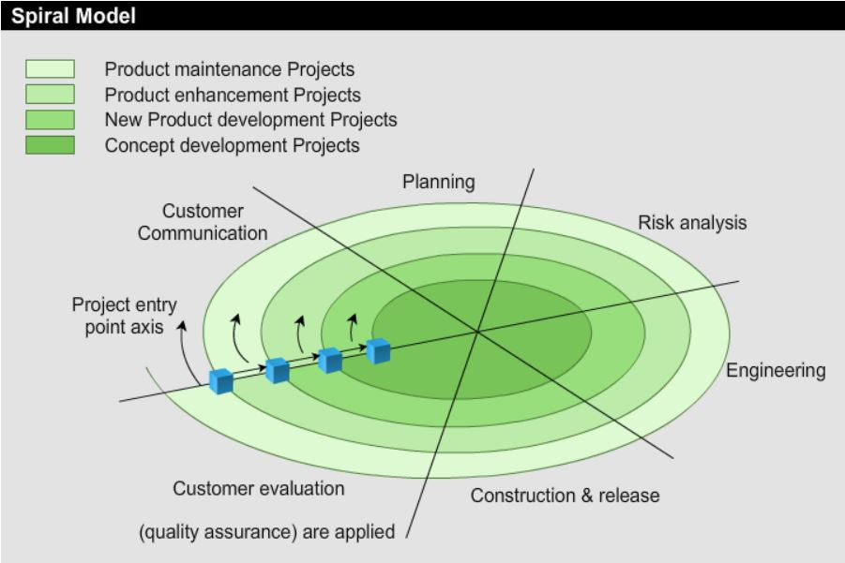
Spiral model

Slide 99
Communication
Task required to establish effective communication between developer and customer

Slide 100
Planning
Task required to define resources, timeline and other project related information

Slide 101
Risk analysis
Tasks required to access both technical and management risks

Slide 102
Engineering
Tasks required to build one or more representations of the application

Slide 103
Construction and release
Tasks required to construction, test, and provide user support

Slide 104
Customer evaluation
Task required to obtain customer feedback based on evaluation of the software representation created during the engineering stage and implemented during the installation stage.

Slide 105
Evolutionary Model
Concurrent Model

Slide 106
Concurrent Development Model
Provides an accurate state of the current state of project
Focus on concurrent engineering activities process such as prototyping ,analysis modelling, requirement specification
Series of technical activities, tasks

Slide 107
2 ways to achieve the concurrency
System and component activities occur simultaneously can be modeling using state – oriented approach
A typical client / server application is implemented with many component ; each can be designed and realized concurrently.

Slide 108
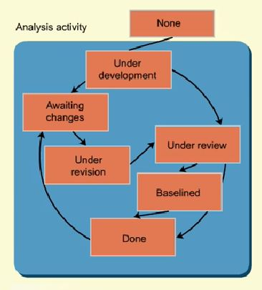
Concurrent Development Model

Slide 109
Unified Model

Slide 110
Unified Model
Proposed by Ivar Jacobson ,Grady Booch and James Rambaugh
Use case driven, architecture centric, iterative and incremental in nature

Slide 111
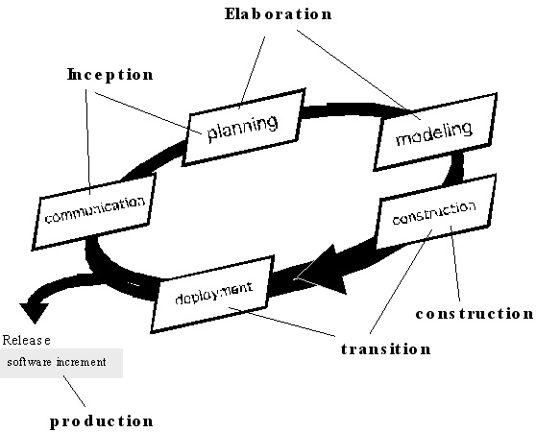
Unified Model

Slide 112
Phases of Unified Model
The Unified Process consists of four phases:
Inception,
Elaboration,
Construction and
Transition.
Each phase is completed in a series of iterations.

Slide 113
Inception
A vision of the product is created. Questions discussed are:
What is the product supposed to do?
Why should my organization embark on a project to build this particular product?
Does my organization have the resources to build this product?
Is it feasible to do so?
How much will this product cost and how much will it bring in?
What will be the duration of the project?
Risk analysis is performed.
Decision whether to go ahead with the project or not is taken.

Slide 114
Elobration
System to be built is analyzed in detail.
Use cases used to document the requirements. Main aim: Get the core architecture and as many use cases as possible.
The core architecture is coded, verified with user and baselined.
Other high-risk requirements are identified and coded.
A project plan is drawn in this phase, resources are allocated and a schedule is planned.
UML diagrams are used to model the system under design.

Slide 115
Construction
Remaining use cases are implemented.
If any new use cases are discovered, they are implemented.
Test cases are written, actual tests are carried out and a test report is prepared.
Documentation for the system as well as guides for the users are written.

Slide 116
Transition
System is installed in its environment and beta-tested.
Feedback is received and System is refined and tuned to adapt in response to the feedback.
It also includes activities like marketing of the product and training of users.

